Slide 1
Predicting Wine Quality
Lab Group: ECAD1
Kimberly Khow Qian Yu
Heng Yong Ching
Chung Min Phylicia

Slide 2
OVERVIEW
01
PROBLEM DEFINITION
02
EXPLORATORY DATA ANALYSIS
03
MACHINE LEARNING
04
OUTCOME
Notes:
This is an overview of our presentation. We will first go through our problem definition, followed by the exploratory data analysis, machine learning & outcome of our project.

Slide 3
01
Problem Definition

Slide 4
RELEVANCE OF RED WINE
2018:
38.7%
of people aged 18 - 29 years old drank red wine regularly in the U.S.
Notes:
Red wine is one of the most popular types of wine among wine-drinking adults, and in 2018, 38.7% of people aged 18 to 29 years old were found to drink red wine on a regular basis in the U.S. This highlights the significance of red wine in many people’s daily lives, and is a reason why we chose to explore in detail. However, although many people do drink red wine, it may be hard for them to be sure of the wine quality before purchasing them.
https://www.statista.com/statistics/228269/wine-consumption-usa/

Slide 5
How can we predict whether a wine is good or bad based on its components?
PROBLEM DEFINITION
Notes:
Hence, this leads us to our problem. How can we predict whether a wine is good or bad based on its components?

Slide 6
Aim of project: Helping consumers choose the best wine
PROBLEM DEFINITION
Notes:
In our project, we aim to help consumers be more certain of the quality of a wine just by looking at its composition. This can help them to make a more informed purchase decision and elevate their shopping experience. From the pov of wine companies, with this better marketing strategy, their sales can also be boosted.

Slide 7
DATA SET: RED WINE QUALITY
Fixed Acidity
Citric Acid
Sulphates
Volatile Acidity
Chlorides
Alcohol
Free SO
Density
Residual Sugar
Total SO
pH
Quality
Notes:
In this red wine quality dataset, we look at a total of 12 factors as listed here, which we believe are important in our prediction of wine quality

Slide 8
DATA SET: RED WINE QUALITY
factors given to predict
Quality

Slide 9
02
Exploratory Data Analysis
Notes:
After defining our problem, we now move on to the next section: exploratory data analysis to help us predict wine quality

Slide 10
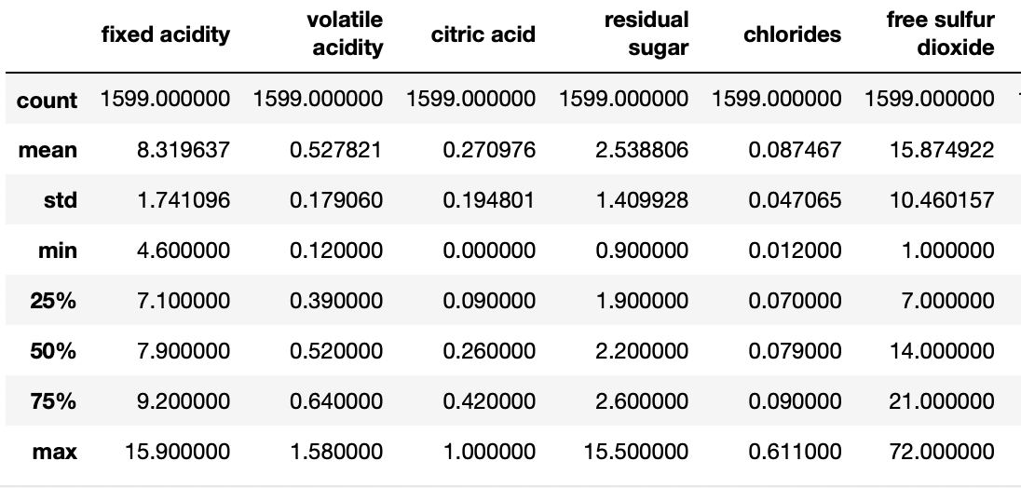
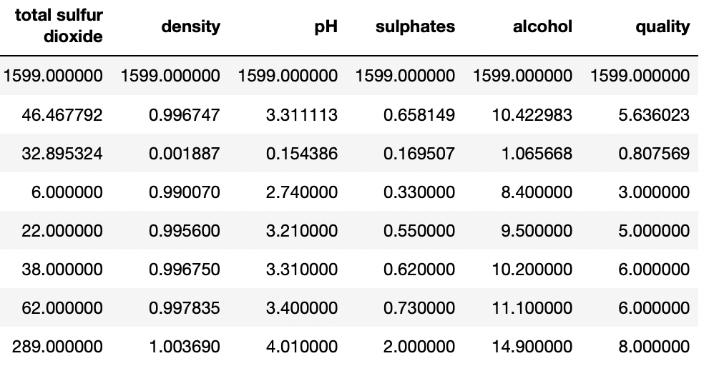
STATISTICAL SUMMARY
Notes:
We first looked at the statistical summary of all our variables to see how they are generally spread out in our dataset. This allows us to find various essential data, such as the mean and standard deviation of a variable, at a glance.

Slide 11
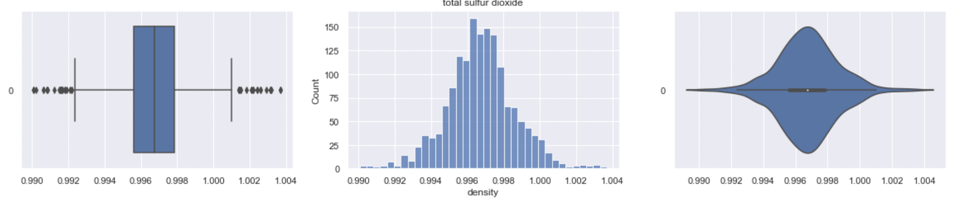
PLOTS
Notes:
Next, we explored the box plots, histogram and violin plots of each of the variables to help us better visualise our data. Using such graphs, we can easily see where each quartile of our variable lies in. For instance, in the case of density, we can tell that its median is around 0.997, as well as how its count changes as density values change. In particular, box plots also enable us to spot the outliers in our data, which we may need to take into consideration when carrying out our analysis.

Slide 12
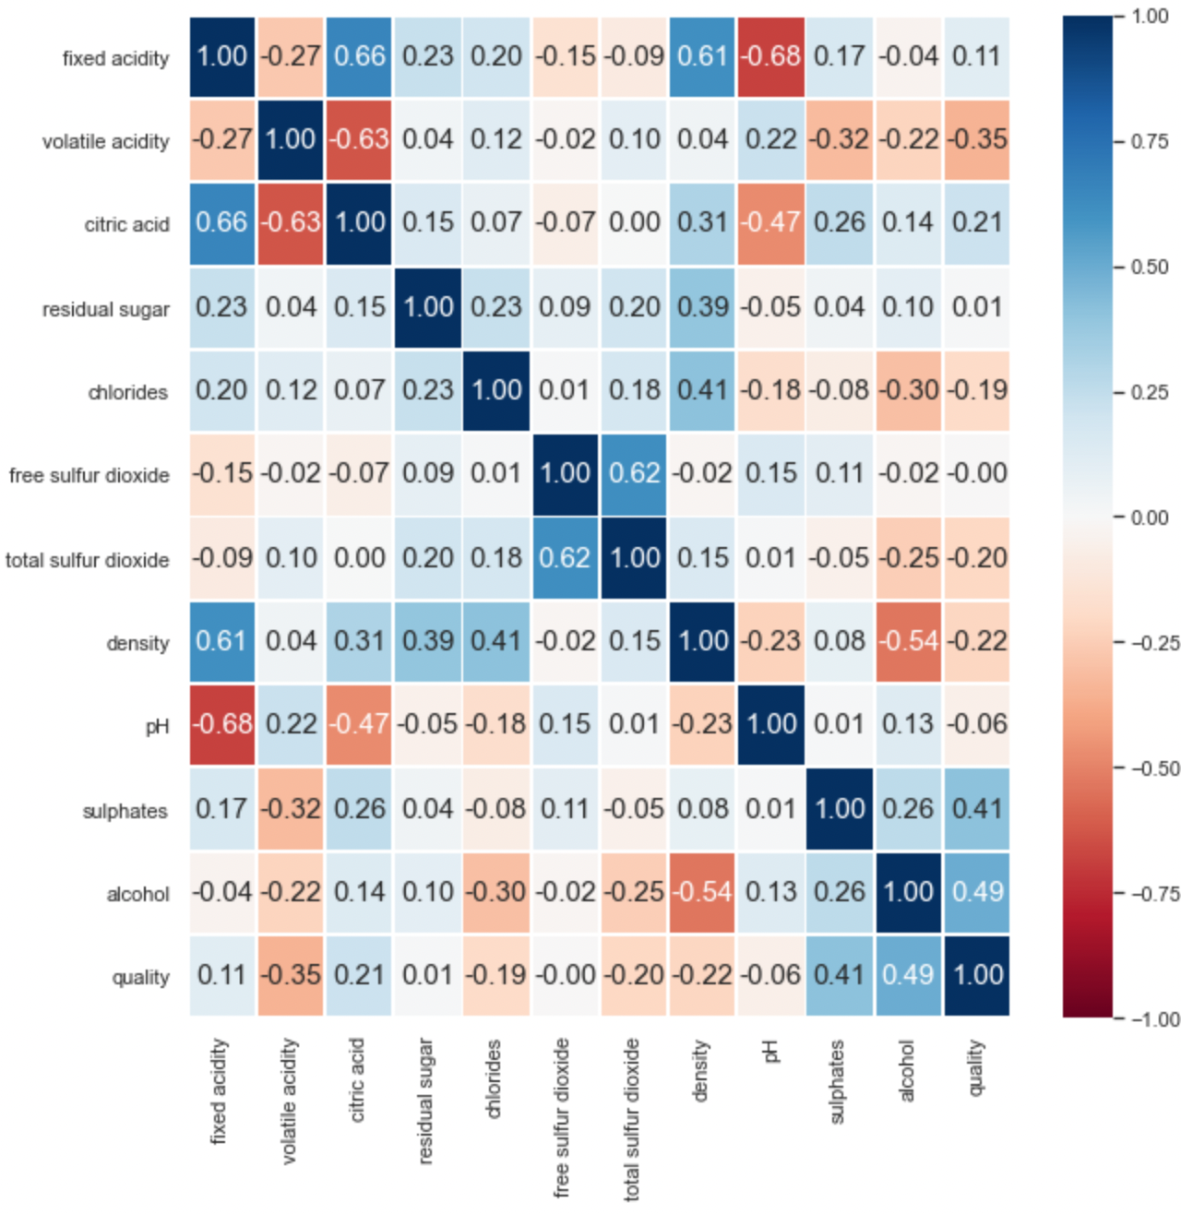
CORRELATION
Notes:
Following the 3 graphs, we plotted a correlation heatmap to get a sense of how each variable affects another

Slide 13
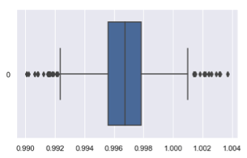
CLEANING DATA
EG. DENSITY
Remove outliers (points beyond both ends of whiskers)
Notes:
We then proceed to clean our data, removing outliers which are defined as points beyond both ends of whiskers. Detecting and removing outliers reduces the variance of the training data and improves test accuracy, which helps us to make our model more accurate in predicting wine quality

Slide 14
ADDITIONAL COLUMN: NEW QUALITY
“Bad” Wine
Quality: 0 to 5
“Good” Wine
Quality: 6 to 10
Notes:
Next, we added an additional column, new quality of wine. Wine with quality ranging from 0 to 5 is classified to be bad wine, while wine with quality ranging from 6 to 10 is classified as good wine. With this simple classification, consumers can view quality of their wine at a quick glance and from there make a speedy decision when purchasing.

Slide 15
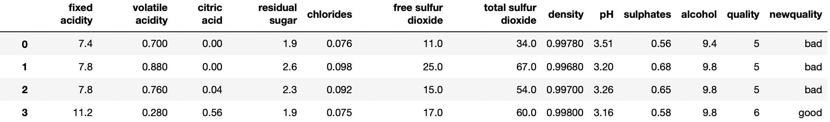
ADDITIONAL COLUMN: NEW QUALITY
Notes:
Here is a snapshot of the new quality column that we added into our data

Slide 16
03
Machine Learning
Notes:
Now, moving on to the machine learning part of our project.

Slide 17
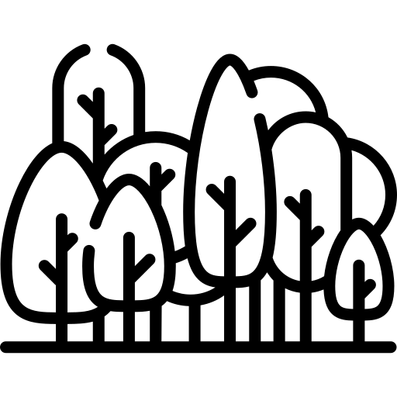
MACHINE LEARNING MODELS USED
DECISION TREE
RANDOM FOREST
classification tree
to predict whether a wine is classified as “good” or “bad”
consists of many individual decision trees put together
use this model to predict whether a wine is “good” or “bad”
Notes:
Firstly, our group decided to make use of the decision tree model to help predict whether the wine is classified as “good” or “bad”. We made use of the classification tree since we want to classify the wines into 2 groups, splitting them based on categorical factors like alcohol content and pH for example.
Our group also found that aside from using what we learnt in the lab sessions, we can make use of the random forest model to achieve our aim. The random forest model works almost similar to the decision tree model, but instead of just making a prediction based on one tree, the random forest model consists of many individual trees grouped together to make the prediction, hence, should create a more accurate prediction.
https://medium.com/swlh/decision-tree-classification-de64fc4d5aac

Slide 18
DECISION TREE
Identifying Response and Predictors
Splitting the Dataset into Train and Test
Plotting the Tree
y = new quality
x = factors
train : test
= 3 : 1
using the factors, we classify the wines by “newquality” (i.e. bad or good)
Notes:
Next, our team plotted the decision tree. We identified the response and predictors of our data, where the response would be the new quality we assigned to the wines and the predictors would be the various factors in the data set.
Then, we split the data into train and test data sets in a 3 is to 1 ratio, and subsequently, we plotted trees for both data sets.

Slide 19
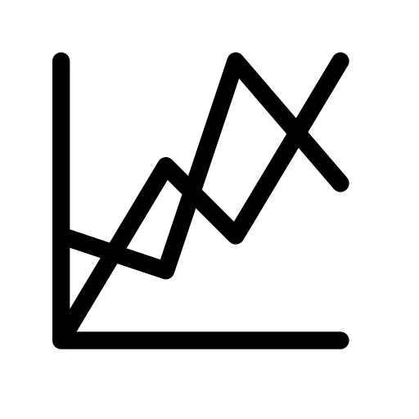
RANDOM FOREST MODEL
Plot Confusion Matrix for Train Dataset
Plot Confusion Matrix for Test Dataset
Notes:
We then plotted the confusion matrices for both train and test datasets, in order to generate the classification accuracy of the model.

Slide 20


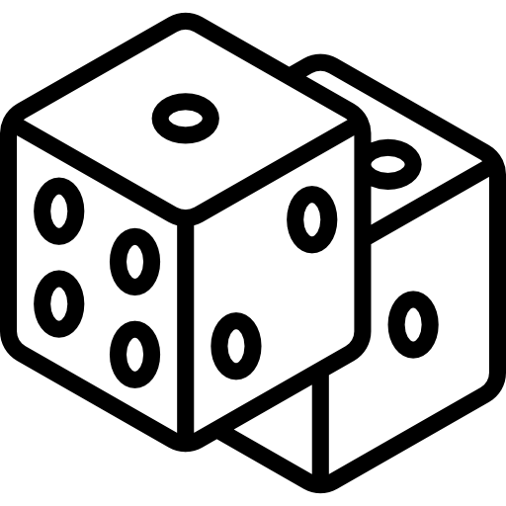
DECISION TREE
Picking Out Unique Wines
Predict Quality of the Unique Wines
Tabulate Probability
that the quality of the wine is “good”
Notes:
To evaluate the accuracy of our prediction using the decision tree model, we picked out 3 unique wines and we predicted their new quality. We also tabulated the probability of the wines getting predicted as good.

Slide 21

RANDOM FOREST MODEL
Identifying Response and Predictors
Input Values for the Random Forest Model
Plotting the Forest
y = new quality
x = factors
allocate the number of trees in the forest
set the depth of each tree
Notes:
For the random forest model, we did almost the same thing but when plotting the random forest, we needed to allocate the number of trees that would be a part of the forest, as well as the depth of each tree.

Slide 22
RANDOM FOREST MODEL
Plot Confusion Matrix for Train Dataset
Plot Confusion Matrix for Test Dataset
Notes:
To find the classification accuracy of the model, we plotted confusion matrices as well.

Slide 23
RANDOM FOREST MODEL
Picking Out Unique Wines
Predict Quality of the Unique Wines
Tabulate Probability
that the quality of the wine is “good”
Notes:
Using the same 3 unique wines that we picked out to evaluate the decision tree model, we predicted the qualities again but this time using the random forest model. And we generated the probabilities that the wines were good again too.

Slide 24
04
Outcome
Notes:
After analysing our data, we now come to the most important part - the outcome of our model.

Slide 25
INSIGHTS - IMPORTANT FACTORS
DECISION TREE
The higher the variable occurs in the tree, the more important it is
More important factors in predicting quality:
Alcohol
Sulfates
Notes:
Looking at the decision tree, we realise that the higher a variable occurs in the tree, the more important it is in predicting wine quality. From our decision trees generated, we observe that the relatively more important factors are namely alcohol and sulphates

Slide 26
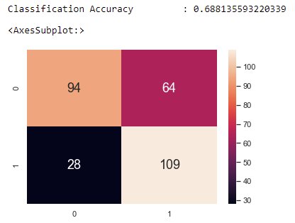
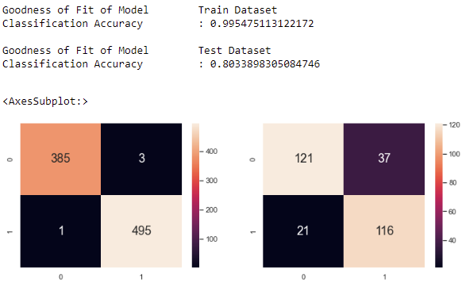
INSIGHTS - COMPARING THE MODELS
Goodness of Fit of Model for: Test Set
Notes:
Looking at the goodness of fit of model for our test set, we see that the classification accuracy for random forest 0.80339 is much higher than the classification accuracy for a single decision tree of 0.68814, showing that utilising random tree is more accurate than decision tree

Slide 27
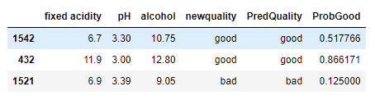
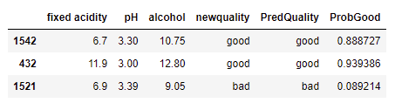
INSIGHTS - COMPARING THE MODELS
Probability that the “newquality” of wine is predicted as “good”
Notes:
Furthermore, putting the calculated probability of the 2 models on side by side comparison, we can clearly see the improvement in prediction of new quality using the random forest model. The significant improvement can be seen across all three examples, further confirming our hypothesis that the random forest model consisting of many individual trees grouped together, creates a more accurate prediction than a single decision tree.

Slide 28
INSIGHTS
RANDOM FOREST
solves the original problem that was stated before
can help to prevent overfitting of the tree model
more accurate in predicting whether a wine is good or bad
Notes:
The benefits of using random forest also shone through in our results. With random forest, we are able to solve the original problem that was stated before without overfitting the tree model. This method is also more accurate than just decision trees in predicting whether wine is good or bad. this is something that was not taught in lab sessions and we are happy to have learnt something new through the journey of the project
https://towardsdatascience.com/3-techniques-to-avoid-overfitting-of-decision-trees-1e7d3d985a09#:~:text=Is%20your%20Decision%20Tree%20Overfitting,fails%20to%20capture%20important%20patterns.

Slide 29

THANK YOU
Notes:
With the help of data science, predicting wine quality is much simpler than you think. For you wine lovers out there, we hope our project can bring yall fun and convenience when choosing wine! Thank you :)

